Slide 1
730 Final Project
Shortest Path Optimization model
Binhao Chen
Peter Mei

Slide 2
Purpose of shortest path optimization model
Route optimization in logistics from Point A to Point B
Uncover the optimal path of transportation
Minimize traveling distance subject to constraints
State 1
State 3
Point A
State 2
State 6
Point B
State 4
State 5

Slide 3
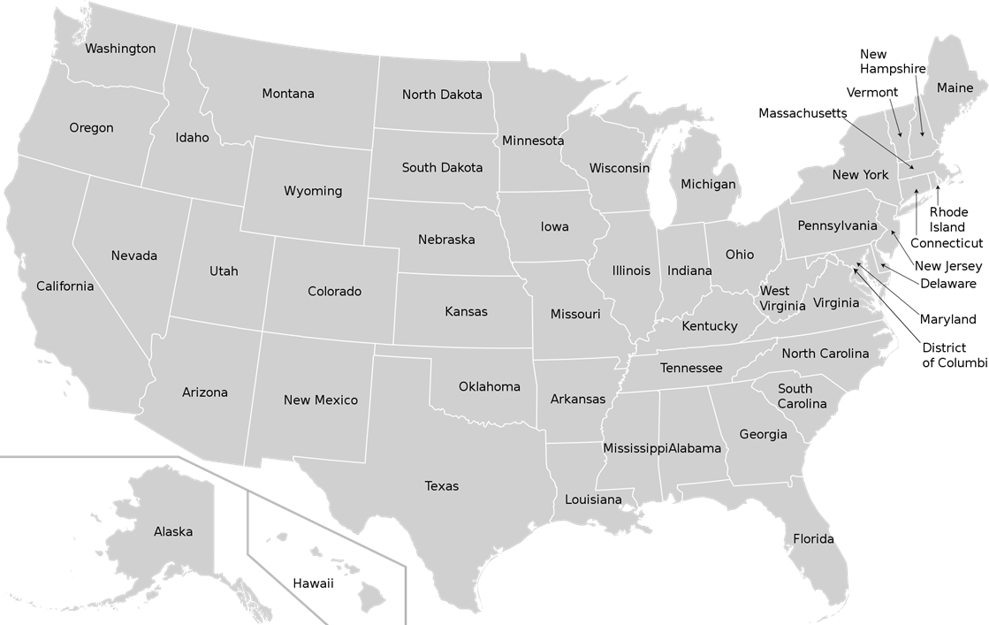
Business context
We are a logistics company that aims to deliver goods from Texas to Washington through various truck types/classes. Our route paths are limited to states within the Blue Region depicted in the map bottom right. We have 6 different truck classes with varying weight capacities and fuel consumptions. Our goal is to determine the optimal path for each truck class subject to constraints.

Slide 4
Model Set Up (Part 1)
Objective - Minimize total distance traveled
Decision variables - Binary variables for each state-to-state distance. 1 represents route is chosen, 0 represents the route is not chosen.
Constraints
Texas netflow = 1, Washington netflow = -1, Other states netflow = 0
Each truck class can cross at most 7 state borders
Costs generated from tolls and fuel consumption should be under budget depending on truck class
Trucks in classes 1-3 need to pass exactly 1 equipment check and maintenance facility. Trucks in classes 4-6 need to pass exactly 2 of those facilities.

Slide 5
Model Set Up (Part 2)
Objective can be calculated using SUMPRODUCT(Distance, Binary DVs).
Toll costs vary across states and truck classes. For each state, there will be a toll cost exercised on a truck’s carrying weight (kg) plus a fixed toll cost collected based on a truck’s class.
Fuel cost is calculated using average real-time diesel price and distance traveled.
There are a total of 5 equipment check and maintenance facilities in state Nebraska, Utah, Nevada, North Dakota and Montana. It is required for trucks, depending on truck class, to pass through 1 or 2 of these states for vehicle diagnosis and check up before arriving destination.

Slide 6
Key Assumptions
We will only keep the path matching two states’ central point and ignore all alternative routes, therefore, we can have specific input to get the distance value.
The distance value from Google map is the real route value, rather than direct line.
Most of transaction finished in 3 days, therefore, price of oil will not fluctuate.
States with higher standard of living will have higher toll rates.
Each truck class will handle their corresponding maximum carrying capacity

Slide 7
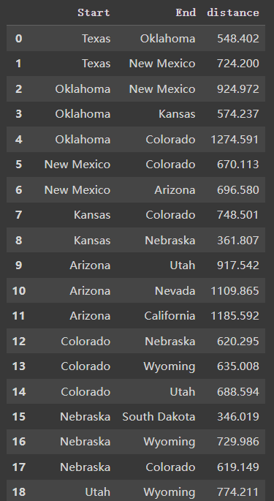
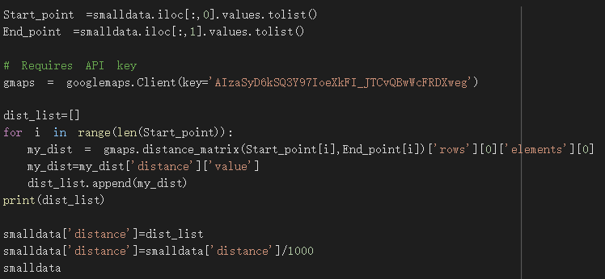
Real input data
Build the API on Google Map
Extract the real distance(km) between two places

Slide 8
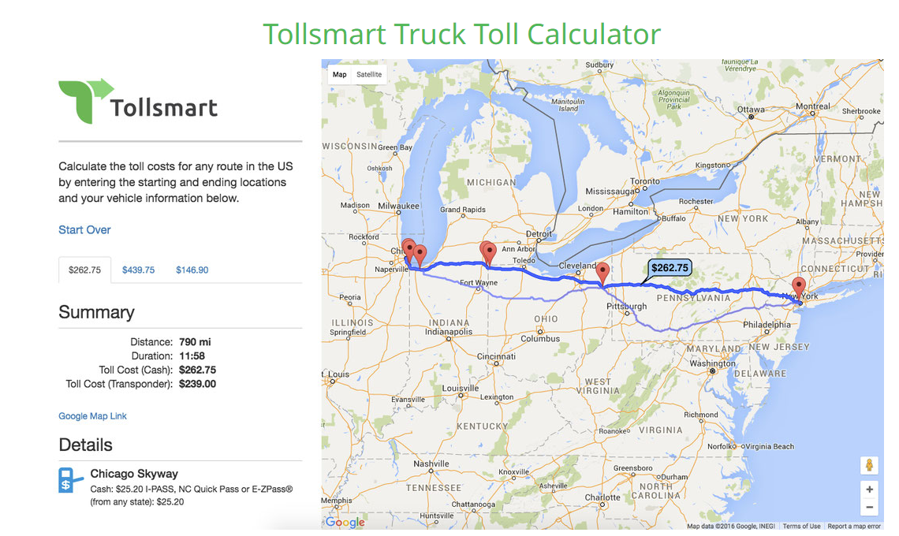
Real input data
tolls costs from Tollsmart.com
Status: Applying for API

Slide 9
Current ideas for further analyses or extensions?
Right now, we only consider tolls and travelling expense. We can find the result that more relates to the distances between two places. But we still want to find some critical contributors.
Scenario Analysis
We set different types for truck types, vehicle dimensions, delivering weights and oil prices.
Based on assumptions, out data can’t meet city-sized situation right now.
We only choose the path by matching two central points between states.

Slide 10
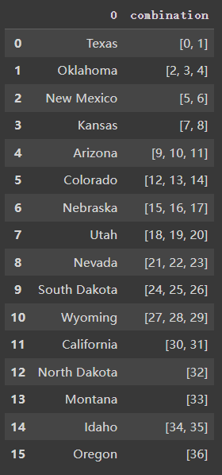
What are you currently struggling with？
The application of constraint in python. (index of model x)
We will use the combination for constraint of netflow.
The coefficient of distance has large contribution to the model, we are trying to find some other critical contributors.

